Slide 1
ASL and Emotion Translator
Yassine Ghannane, Pegah Khayatan

Slide 2
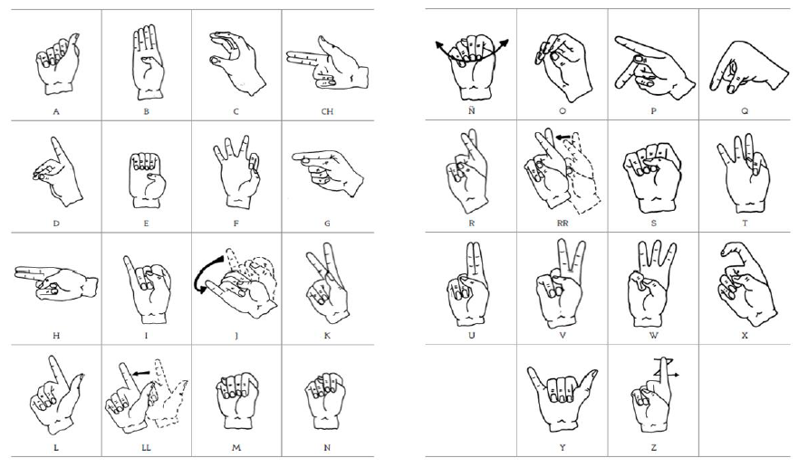
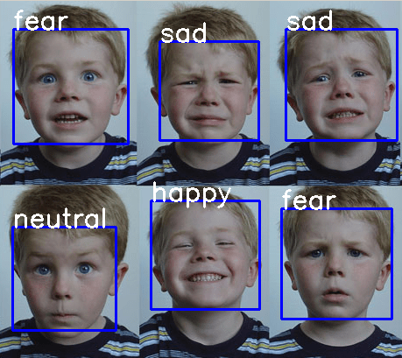
Motivation
ASL and Emotion detection translator

Slide 3
Table of contents
ASL translation
Histogram
Convolutional neural network
Emotion detection
Feature extraction
Histogram equalization
Face localization
Extracting Landmarks

Slide 4
ASL Translator is composed of
Histogram
- A statistical structure which can be used for object detection when used as a threshold
Convolutional neural network
A class of neural networks ideal for data with a grid-like topology
Spatial relations between separate features are taken into account during convolution and/or pooling

Slide 5
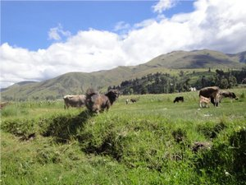
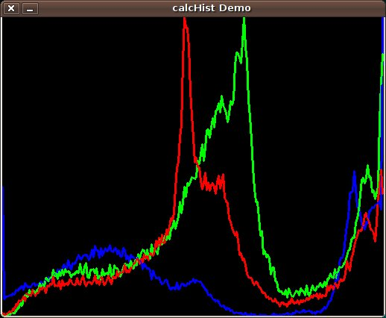
Histogram
Histograms are collected counts of data organized into a set of predefined bins

Slide 6
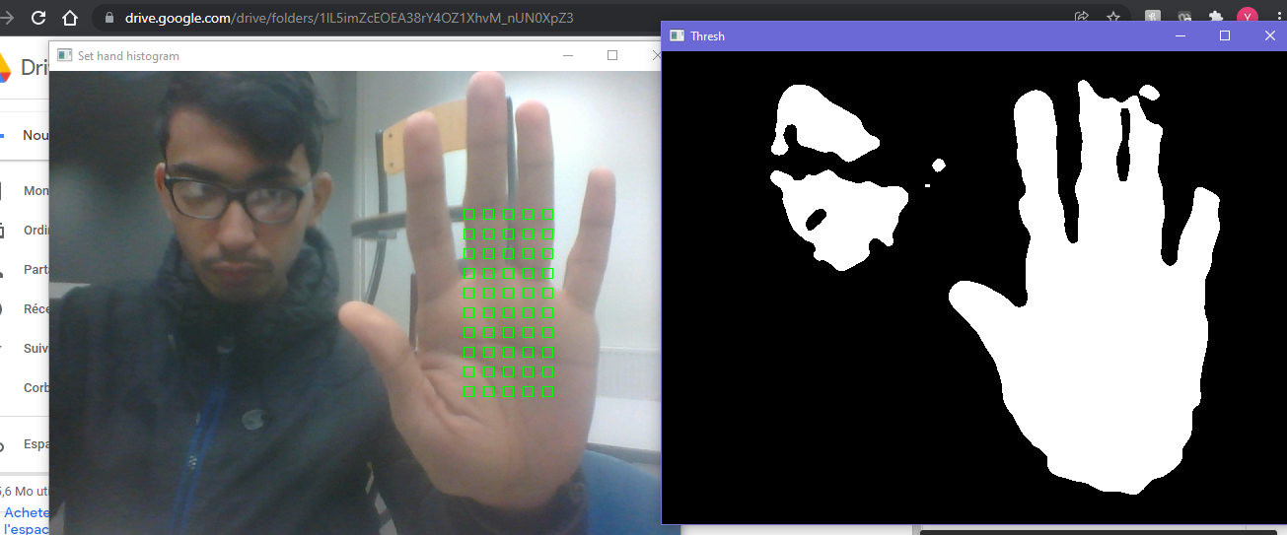
Histogram
Back Projection is a way of recording how well the pixels of a given image fit the distribution of pixels in a histogram model

Slide 7
Convolutional Neural network
The model : ((https://github.com/EvilPort2/Sign-Language/blob/master/cnn_model_keras2.h5)
Input : Image : 50 (height) x 50 (height) x 1 (channel)
Convolution : 2x2 kernel, activation='relu'
Max pooling : 2x2 kernel, 2x2 strides
Convolution : 3x3 kernel, activation='relu'
Max pooling : 3x3 kernel, 2x2 strides
Convolution : 5x5 kernel, activation='relu'
Max pooling : 5x5 kernel, 5x5 strides
Flatten
Dense : 128 connected neurons, activation='relu'))
Dropout : p = 0. 2
Dense : 43 connected neurons, activation='softmax'
Output : 1 of 43 classes

Slide 8
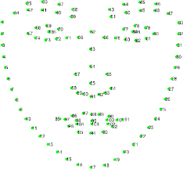
Using dlib to detect emotions
Pretrained models to extract landmarks: https://github.com/davisking/dlib-models
The dataset used to train the emotion detector: http://www.consortium.ri.cmu.edu/data/ck/
What ddo we do with landmarks?

Slide 9
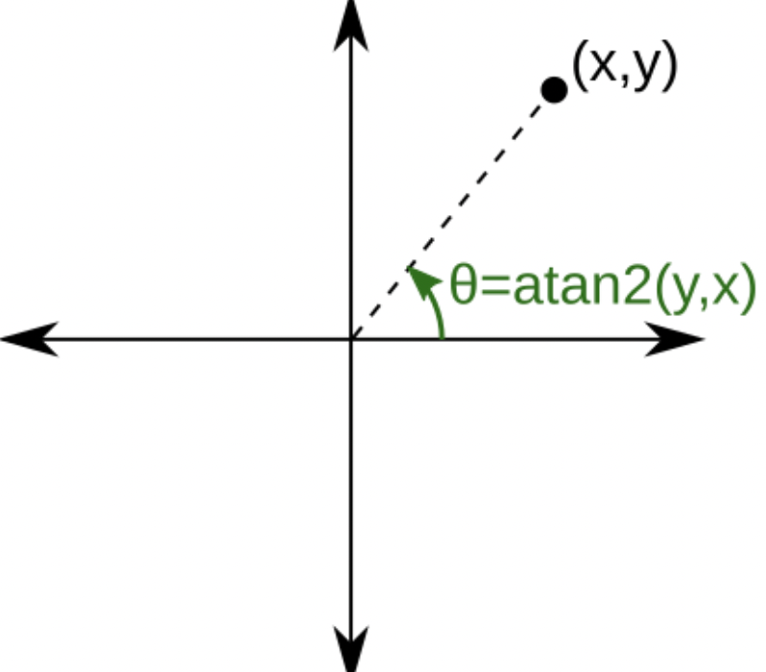
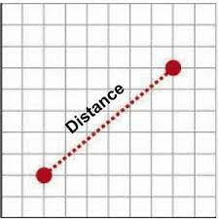
Extracting features from the landmarks
68 points
136 Features

Slide 10
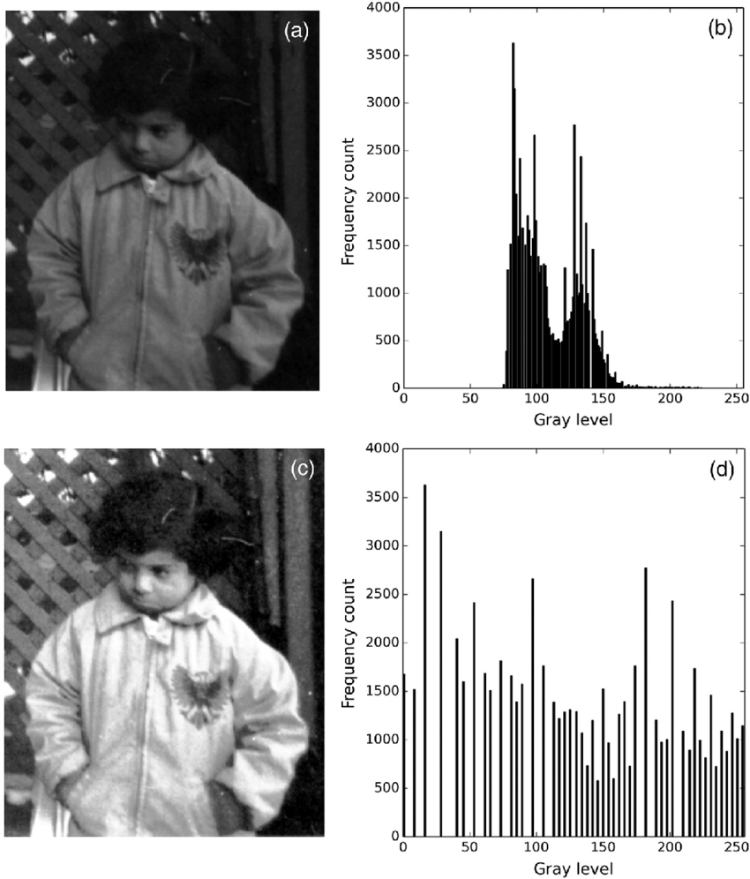
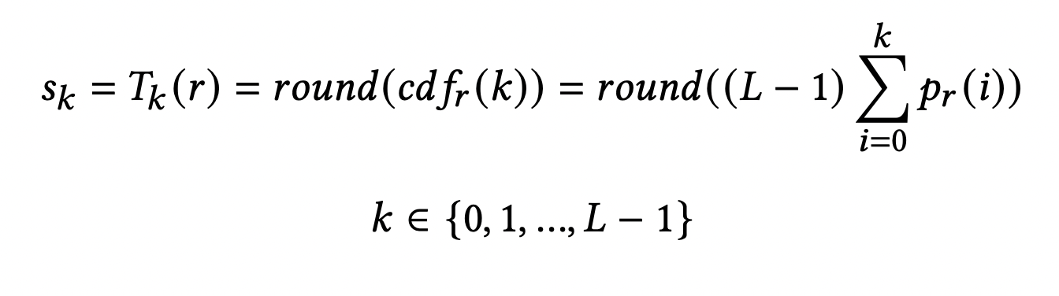
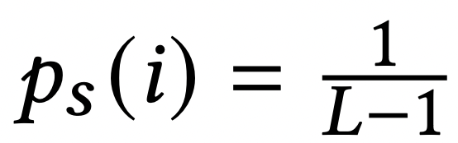
Histogram equalization

Slide 11
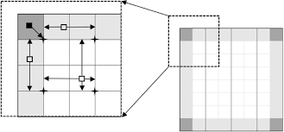
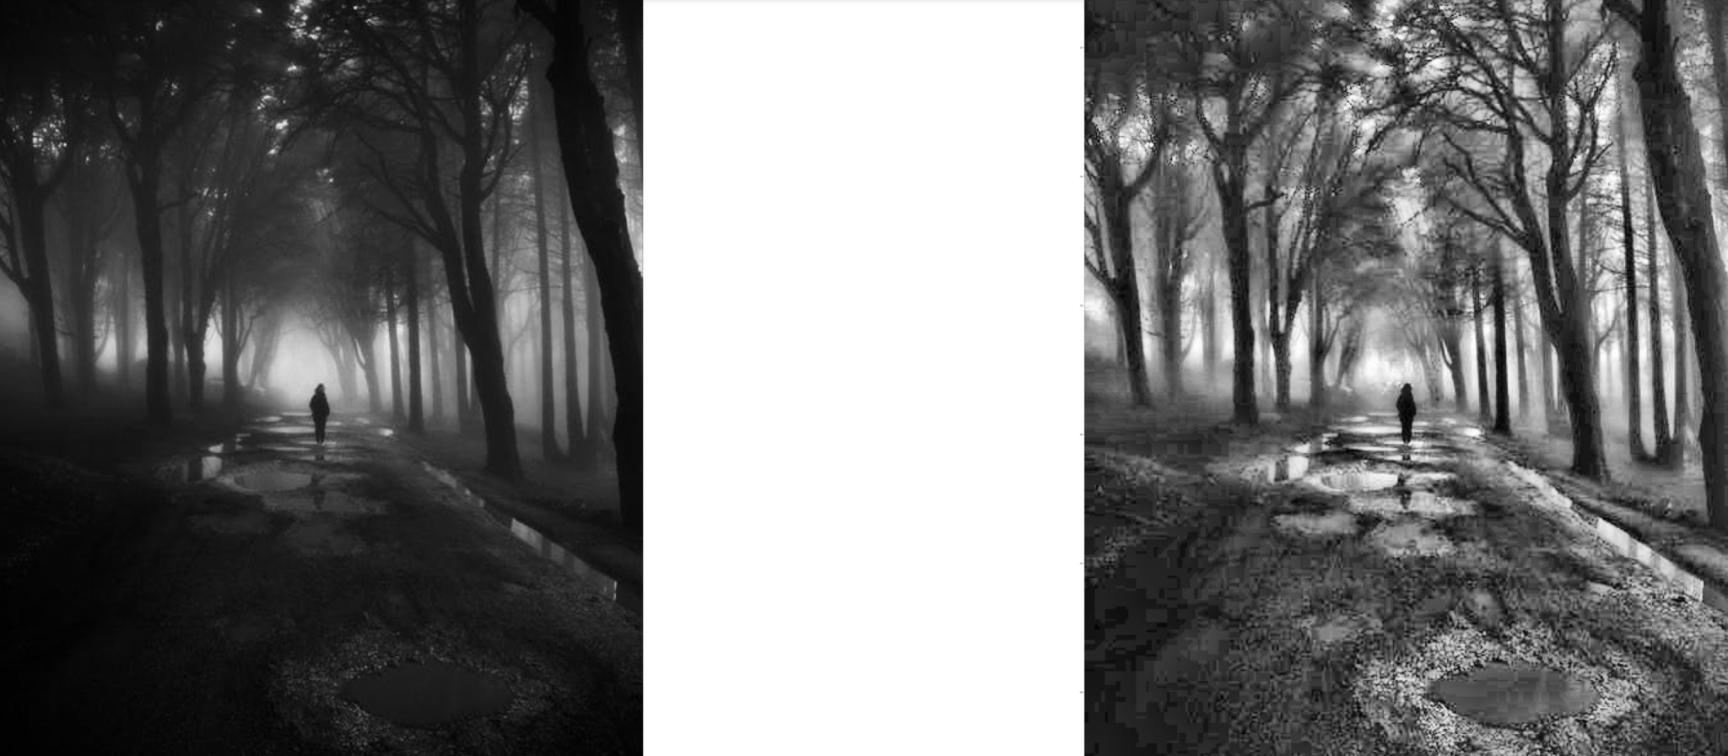
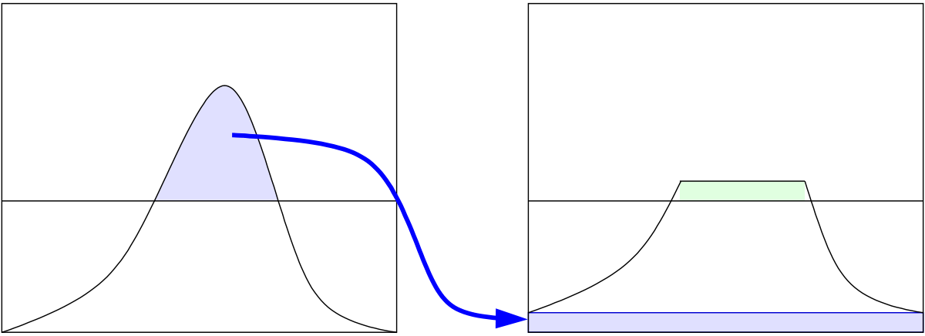
Contrast Limited Adaptive histogram equalization

Slide 12
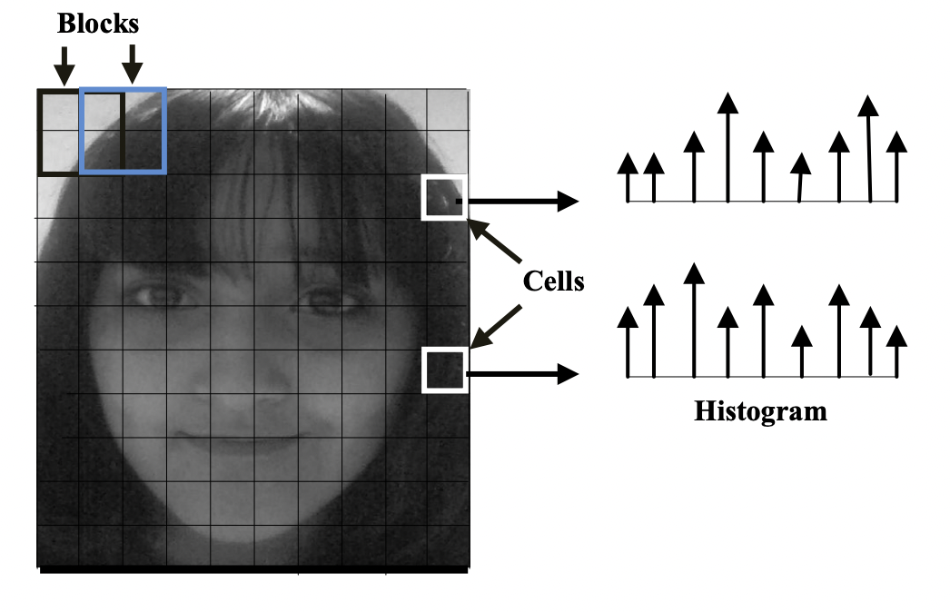
Behind face localization algorithm in dlib
HOG+SVM
Not invariant to changes in rotation and viewing angle.
Max-Margin (MMOD) CNN face detector capable of detecting faces from varying viewing angles, lighting conditions, and occlusion.

Slide 13
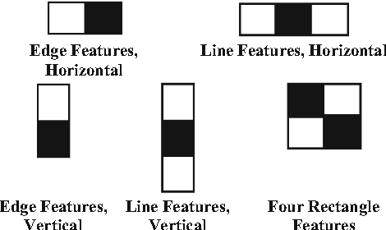
Behind landmark detection in dlib
Method in dlib is based on: One millisecond face alignment with an ensemble of regression trees
Based on Viola jones:
Haar Features: Value = Σ (pixels in black area) - Σ (pixels in white area)
Integral image
Adaboost Learning
Cascading classifiers

Slide 14
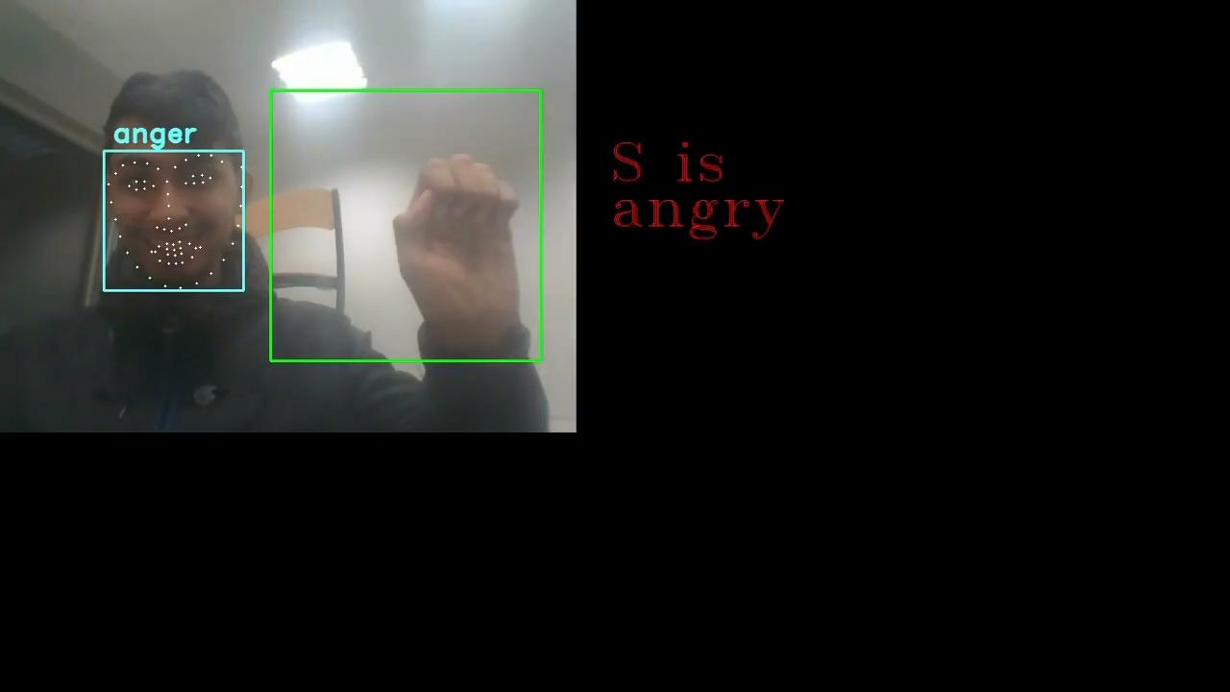
Some results

